Slide 1
COURSE PROJECT / DSA0135
Student Management
System
A complete C++ application demonstrating advanced Object-Oriented Programming concepts.
COURSE
FACULTY
Object Oriented Programming For C++ in Real Time Applications
Dr. Smitha · Dr. Sarasu
SUBMITTED BY
DEPARTMENT
Abinesh M (192465050)
Vignesh P (192424040)
Computer Science & Engineering
Saveetha School of Engineering (SIMATS)
Notes:
Welcome and quick context: this is our DSA0135 project — a Student Management System in C++ that demonstrates the major OOP paradigms. Submitted to Dr. Smitha and Dr. Sarasu.

Slide 2
01 · INTRODUCTION
What is a Student Management System?
A software application that maintains student records with complete CRUD support — Create, Read, Update, and Delete — built around clean object-oriented design and dynamic memory management.
▣
△
❖
✓
CRUD Operations
OOP Foundations
Modern C++ (C++17+)
Validation & Safety
Add, view, search, update, and remove records dynamically.
Inheritance, polymorphism, encapsulation, abstraction.
Smart memory model with new / delete and virtual destructors.
Type-checked attributes prevent invalid data entry at compile time.
Student Mgmt System
DSA0135
Notes:
Frame the problem and the solution at a high level — what an SMS does, and why OOP is the right toolkit.

Slide 3
02 · PROBLEM
Limitations of the Existing System
Spreadsheets and paper registers fall apart at scale. Six issues consistently show up:
Data Redundancy
No Type Safety
Poor Search Performance
Same student detail duplicated across multiple sheets; updates drift out of sync.
A cell accepts anything — alphabetic GPA, negative roll number, malformed email.
Manual Ctrl+F and scrolling do not scale. There is no indexed lookup.
Lack of Modularity
Limited Extensibility
Concurrency Issues
Data and logic live together in one file. No clean entity/operation separation.
Adding a Faculty or Course entity means cloning the entire sheet structure.
Multi-user editing of a shared sheet routinely loses updates and breaks formulae.
Student Mgmt System
DSA0135

Slide 4
03 · SOLUTION
Proposed System — Disciplined OOP Design
Model the domain as first-class C++ objects with strict types, private state, and a well-defined public interface — every limitation of the existing system has a direct OOP answer.
1
Strong typing
Each attribute has an explicit type — invalid entries are rejected at compile time.
2
Encapsulation
All fields are private; controlled access through getters and setters.
3
Inheritance
A reusable Person base class — future Faculty/Staff inherit without duplication.
4
Polymorphism
A single virtual display() handles every derived class through base-class pointers.
5
Operator overloading
Search reads naturally: if (*student == rollNo) — closer to spoken language than calls.
6
Dynamic memory
Records live on the heap with new and are released with delete — concrete RAII practice.
Student Mgmt System
DSA0135

Slide 5
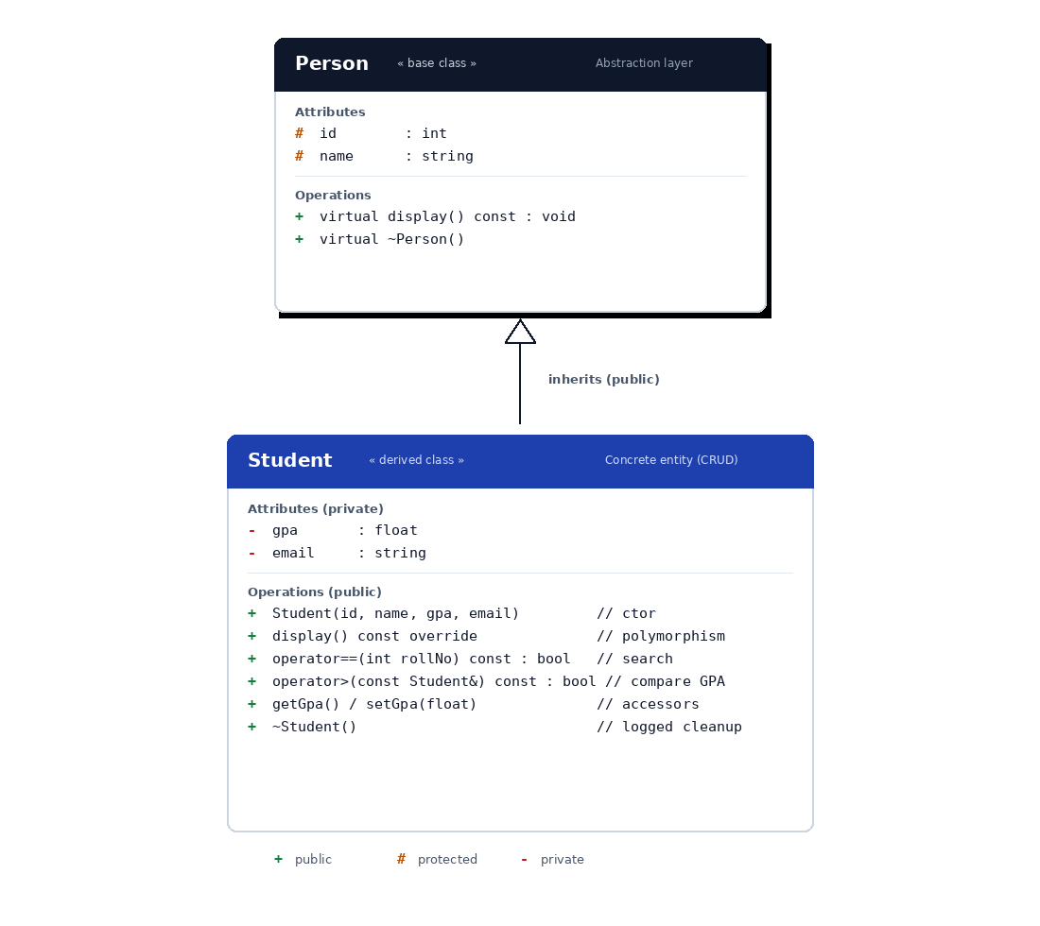
04 · ARCHITECTURE
Class Hierarchy & Module Responsibilities
Three layered modules
Person
Base / Abstraction Layer
Owns id and name. Exposes virtual display() and a virtual destructor so any future entity (Faculty, Staff) inherits cleanly.
Student
Derived / Concrete Entity
Adds gpa and email. Overrides display(), and overloads == (search by roll) and > (compare GPA).
Driver (main)
Orchestration Layer
Holds vector<Student*>. Runs all CRUD operations: Create (new), Read (display/search), Update (setGpa), Delete (delete).
Student Mgmt System
DSA0135

Slide 6
05 · IMPLEMENTATION
Code Walkthrough — Class Definitions
student_mgmt.cpp
Encapsulation
// BASE CLASS — Person
class Person {
protected:
int id;
string name;
public:
Person(int i, string n) : id(i), name(n) {}
virtual void display() const; // polymorphism
virtual ~Person() {} // safe cleanup
};
// DERIVED CLASS — Student
class Student : public Person {
private:
float gpa;
string email;
public:
void display() const override; // override
bool operator==(int rollNo) const; // search
bool operator>(const Student&) const;// compare
private + protected + public access modifiers.
Inheritance
Student : public Person — re-uses base members.
Polymorphism
virtual display() + override = runtime dispatch.
Operator Overload
== for search, > for GPA comparison.
Student Mgmt System
DSA0135

Slide 7
06 · IMPLEMENTATION
CRUD Driver — main()
student_mgmt.cpp — int main()
C
Create
vector<Student*> students; // heap-backed store
// CREATE — dynamic allocation
students.push_back(
new Student(1, "Abinesh M", 9.20, "abx@iiitm.ac.in"));
// READ — polymorphism through virtual dispatch
for (Student* s : students) s->display();
// READ — search via operator== overload
for (Student* s : students)
if (*s == 1) { s->display(); break; }
// UPDATE — controlled mutation through setter
for (Student* s : students) if (*s == 2) s->setGpa(9.10f);
// DELETE — destructor logs cleanup
for (Student* s : students) delete s;
new Student(...) on heap, pushed to vector.
R
Read
Display all & search by Roll No via operator==.
U
Update
setGpa() — only public setters can mutate state.
D
Delete
delete s frees memory; virtual destructor logs it.
Student Mgmt System
DSA0135

Slide 8
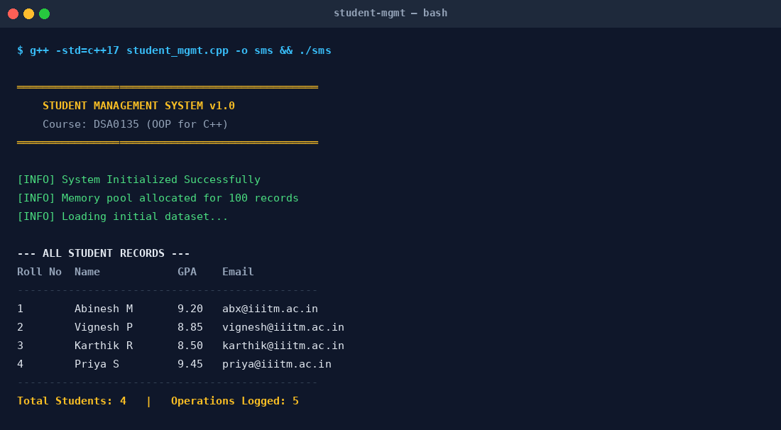
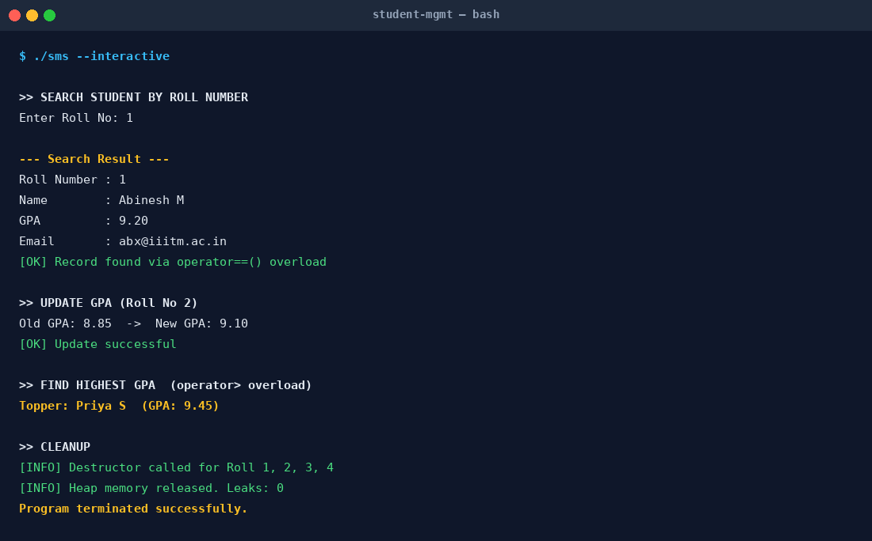
07 · EXECUTION
Sample Output
Program compiled with g++ -std=c++17 and run on a Linux terminal.
Initialization & Display
Search · Update · Topper · Cleanup
All 4 records created on the heap; display() called via virtual dispatch.
operator== finds Roll 1; operator> finds the topper; destructors log each free.
Student Mgmt System
DSA0135

Slide 9
08 · VALIDATION
Test Cases & Results
TC #
Scenario
Input
Expected Output
Result
TC-01
Create student record
new Student(1, "Abinesh M", 9.20)
Object on heap; added to vector
PASS
TC-02
Display all (polymorphism)
Loop s->display()
All records via virtual dispatch
PASS
TC-03
Search by roll (operator==)
*s == 1
Returns Roll 1 record
PASS
TC-04
Update GPA via setter
Roll 2 → setGpa(9.10)
GPA: 8.85 → 9.10
PASS
TC-05
Find topper (operator>)
Scan *s > *top
Priya S, GPA 9.45
PASS
TC-06
Encapsulation enforcement
Direct private access from main()
Compile error (denied)
PASS
TC-07
Cleanup (virtual destructor)
delete s for every pointer
Destructor log for each
PASS
TC-08
Memory leak check
valgrind --leak-check=full
0 bytes lost
PASS
Student Mgmt System
DSA0135

Slide 10
09 · HIGHLIGHTS
Key Features & Outcomes
06
OOP Pillars
04
CRUD Operations
Inheritance, polymorphism, encapsulation, abstraction, operator overloading, virtual destructors — all exercised in one cohesive program.
Create, Read, Update, Delete — each mapped one-to-one with an explicit OOP construct in the codebase.
0
Memory Leaks
08
Test Cases Passed
Verified via Valgrind — every new is matched by delete; virtual destructor guarantees safe cleanup of derived objects.
From record creation to memory cleanup — every scenario produced the expected output without exception.
Student Mgmt System
DSA0135

Slide 11
10 · CONCLUSION
Thank You.
The Student Management System demonstrates every core OOP concept in DSA0135 within a single coherent C++ application. Its clean Person → Student hierarchy makes future extension to Faculty or Staff entities a one-class addition rather than a rewrite — satisfying the Open–Closed Principle.
FUTURE SCOPE
Persistent file I/O
Menu-driven CLI
Exception handling
SQLite integration
Faculty / Staff entities
Abinesh M (192465050) · Vignesh P (192424040)
Guided by Dr. Smitha & Dr. Sarasu · DSA0135 — OOP for C++ in Real Time Applications

